Slide 1







Standardizing the Kinnear Limit of Stokesian Settling (LOSS) parameter using image data analysis
Ola Olagunju, Tim Van Winckel, William Mancell-Egala, Nirmaan Shanker, David Kinnear, Ahmed Al-Omari, Sudhir Murthy, Kimberly Jones and Haydée De Clippeleir

Slide 2
Background
Clarifiers are a limiting step in wastewater treatment processes
Poor settling contributes to clarifier failures
SLR and SOR failures
Reduced effluent quality
Reduced activated sludge recovery
SLR – Solids loading rate, kg/day·m²
SOR – Surface overflow rate, m³/hr·m²
Influent
Effluent
Solids Flux
Sludge Recovery

Slide 3
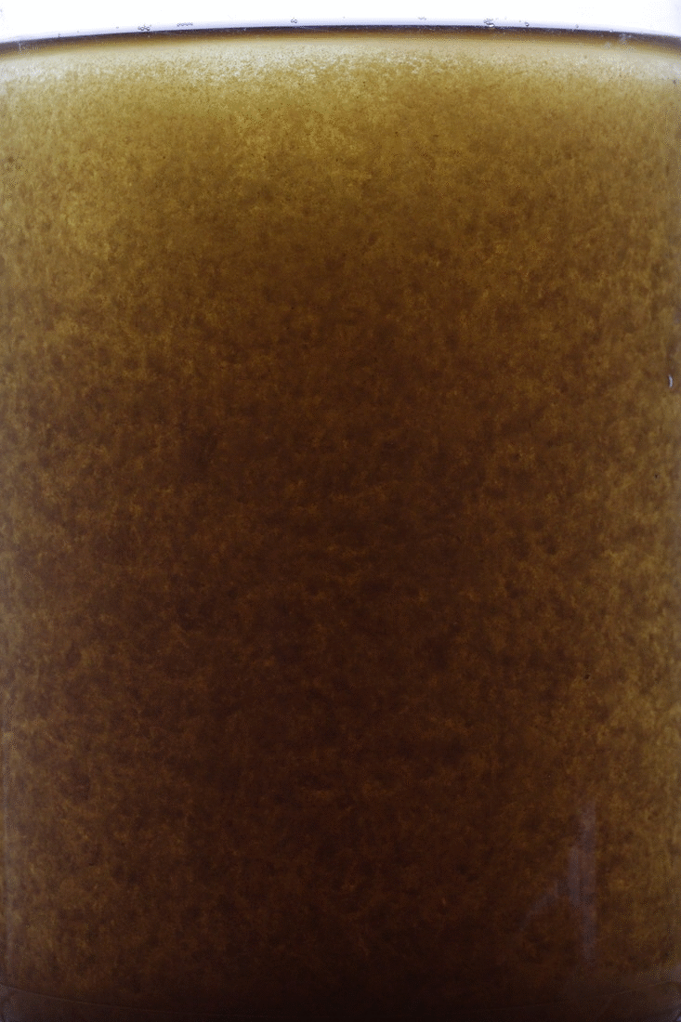
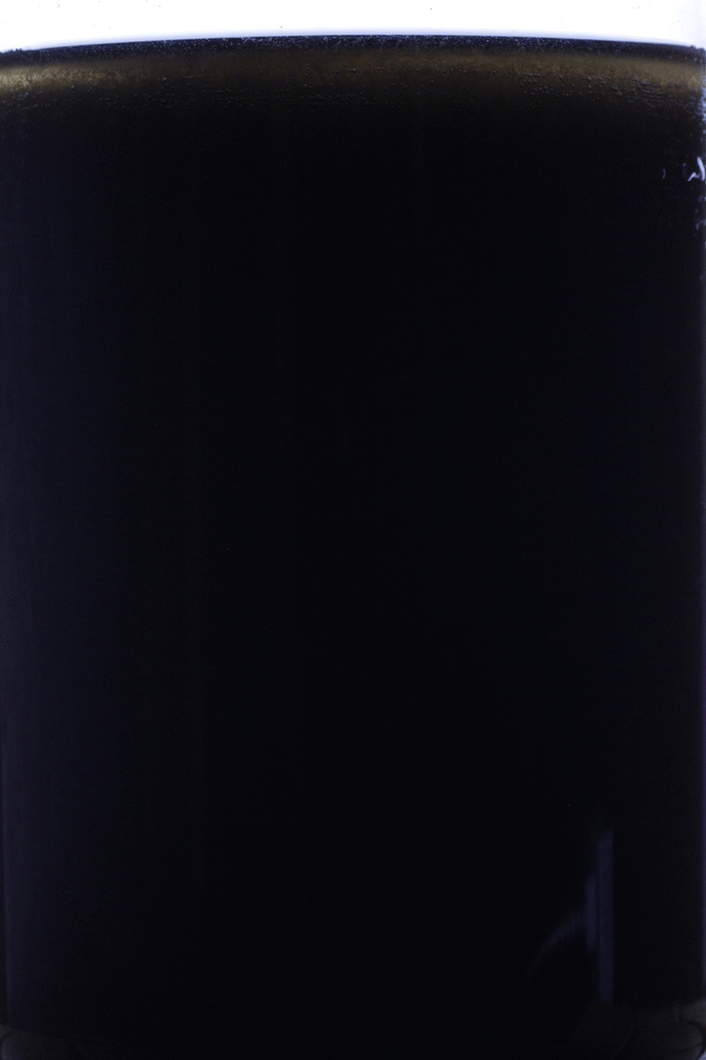
Background
Which settling profile is preferred in clarifiers?
A)
B)
Flocculent Settling (fast)
CSV: 0.6 – 1.5 m/h
Hindered Settling (slow)
CSV < 0.6 m/h

Slide 4
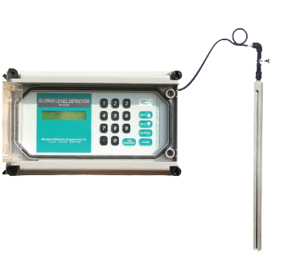
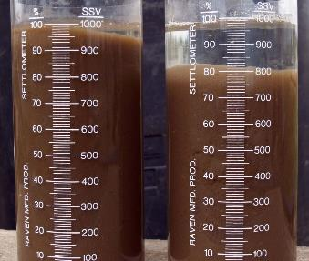
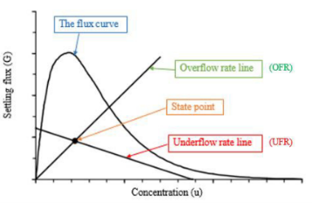
Some Clarifier/Settling Techniques
Sludge Bed Detectors
Sludge Volume Index (SVI) and DSVI
State Point Analysis (SPA)
Markland Specialty Engineering Ltd.
CB Skoura et al., 2016
Biological Waste Treatment Expert

Slide 5
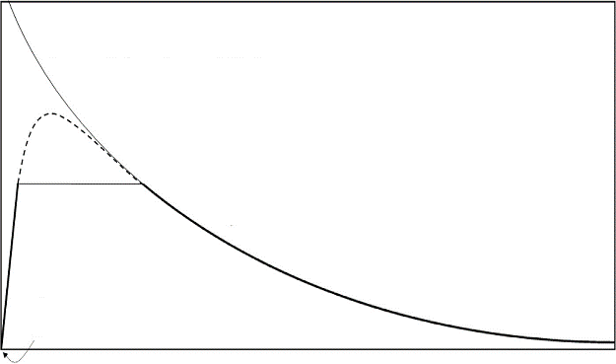
Limit of Stokesian Settling (LOSS)
Aims of parameter
Capture transition from flocculent to hindered
Provide maximum concentration to enter the clarifier feed well
LOSS
Settling velocity (m/h)
Flocculent
Hindered/Compression
Discrete
Non-settleable solids
Concentration (g/L)
Settling velocity model, Mancell-Egala et al., 2016

Slide 6
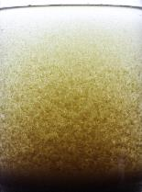
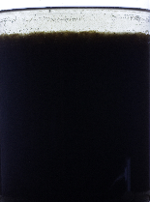
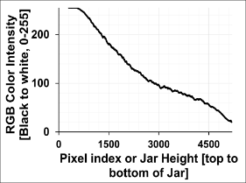
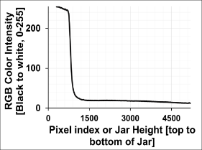
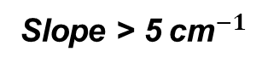
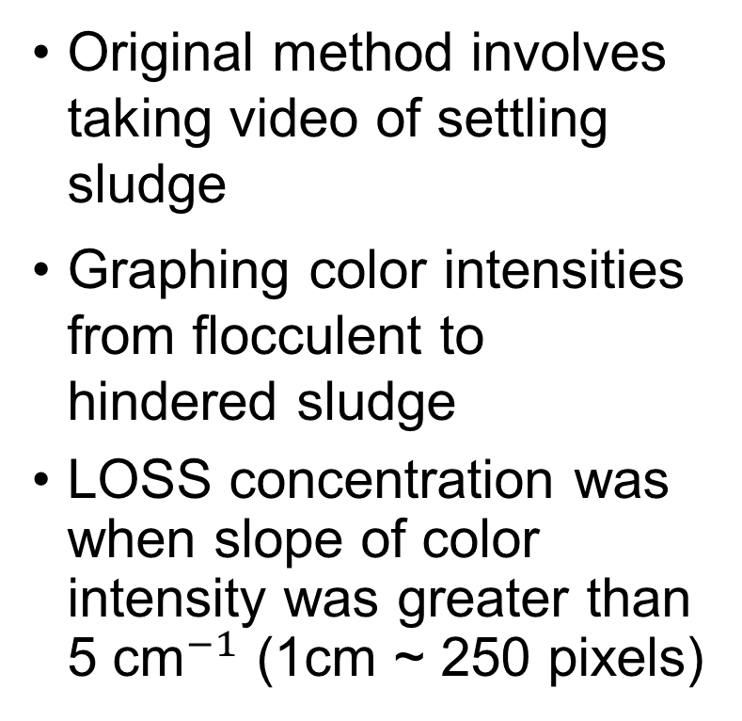
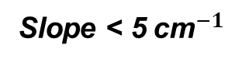
Identifying the LOSS Concentration
Flocculent MLSS
Hindered MLSS
Original method involves taking video of settling sludge
Graphing color intensities from flocculent to hindered sludge
LOSS concentration was when slope of color intensity was greater than 5${ \text{cm}}^{−1}$ (1cm ~ 250 pixels)
Slope < 5 ${\text{cm}}^{−1}$
Slope > 5 ${\text{cm}}^{−1}$

Slide 7
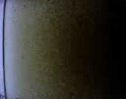
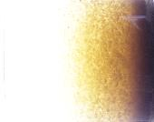
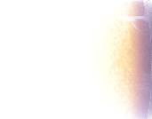
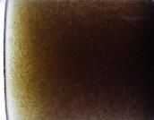
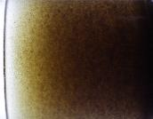
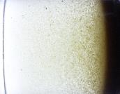
Identifying the LOSS Concentration
All at MLSS of 1000 mg/L
Issues with this method in identifying LOSS
Ease of reproducibility
Slope definition ambiguous and subjective
Time of settling (secs) not standardized
Light conditions not standardized
50s, 5 bri.
50s, 75 bri.
10s, 200 bri.
10s, 25 bri.
20s, 25 bri.
80s, 25 bri.
Brightness from 0 – 255 (black to white)

Slide 8

Goals of Research
Develop new methods for identifying LOSS
Straightforward for anyone
Simply reproducible
Standardize for different settling times and brightness
Rod Engineering

Slide 9
Approach
Blue Plains WWTP, DC 370-518 MGD raw sewage
Secondary WEST
BNR Clarifiers
BNR Nitrification
Secondary EAST
Secondary Clarifiers

Slide 10
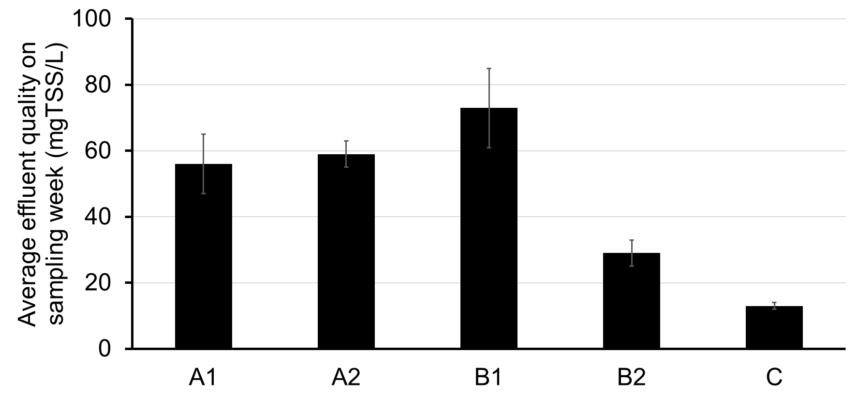
Approach
Samples
Secondary EAST
Secondary WEST
BNR

Slide 11
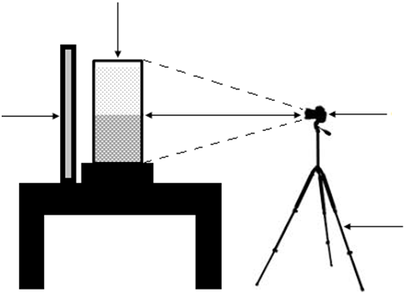
Approach
Jar
Video analysis
Video Image analysis on settling sludge
Hindered to flocculent MLSS
Well mixed mixture
100 rpm for 10 mins
Pictures taken every 10 secs after mixing is stopped
Changing light conditions
Adjusting camera brightness
LED light pad
HD camera
Tripod

Slide 12
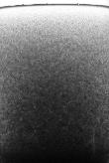
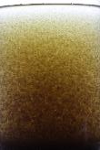
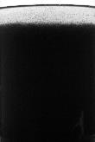
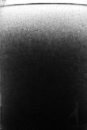
Approach
Converted pictures to 16-bit grayscale (black to white, 0-255)
Sorted pictures
High to low concentration
At the same settling time
At the same Light Intensity/brightness
Significant change in grayscale intensity profile between pictures as concentration decreased indicated LOSS

Slide 13
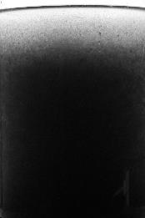
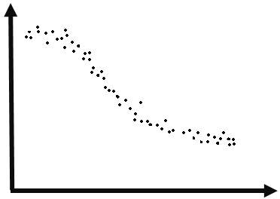
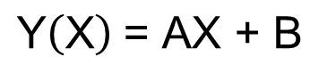
Approach
Simple Linear Regression
$\text{Y}\left(\text{X}\right) \text{=}$ $\text{A}\text{X}\text{ + }\text{B}$
Three methods to find significant change
Linear Fit
Slope and R²
Y, Grayscale Intensity
B,
Y-Intercept
X, Jar Height
Top 1/3rd of Jar

Slide 14
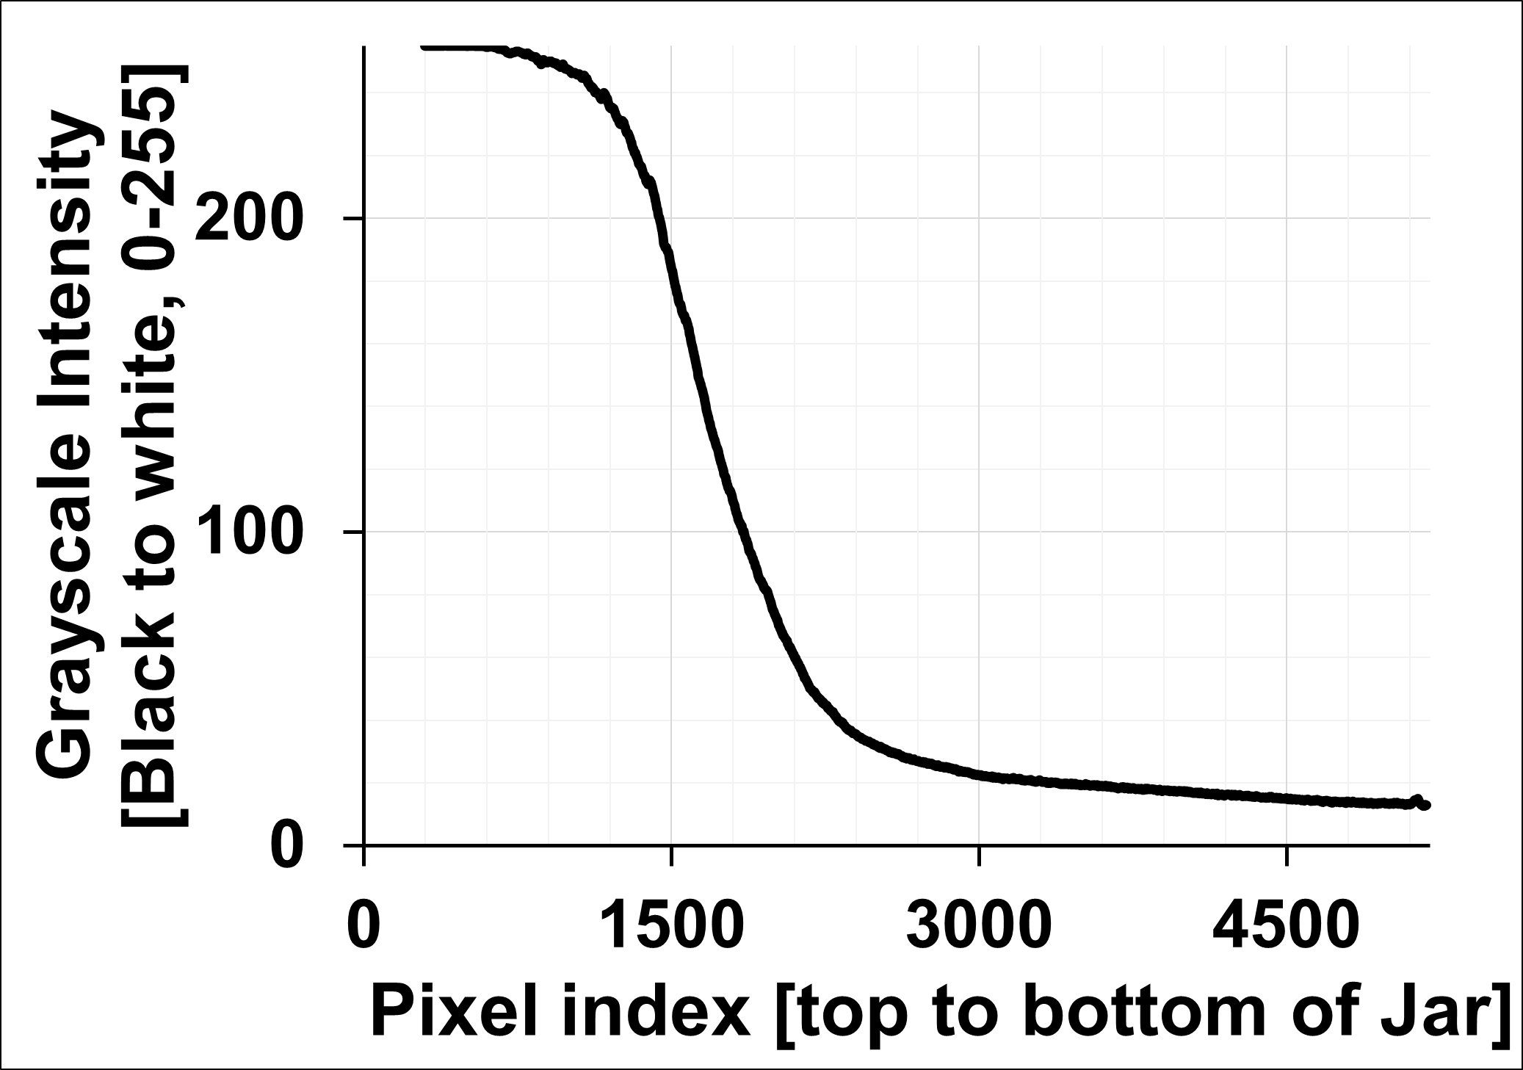
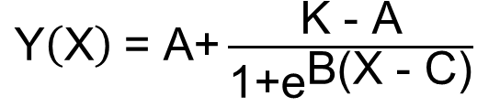
Approach
Generalized Logistic Function
$\text{Y}\left(\text{X}\right) \text{=}$ $\text{A}\text{+}\frac{\text{K}\text{ − }\text{A}}{\text{1+}{\text{e}}^{\text{B}\text{(}\text{X} \text{−} \text{C}\text{)}}}$
Three methods to find significant change
Linear Fit
Slope and R²
Sigmoid Fit
B, C and Fit error
Y, Grayscale Intensity
K, Upper Asymptote
A, Lower Asymptote
X, Jar Height
C, Inflection point

Slide 15
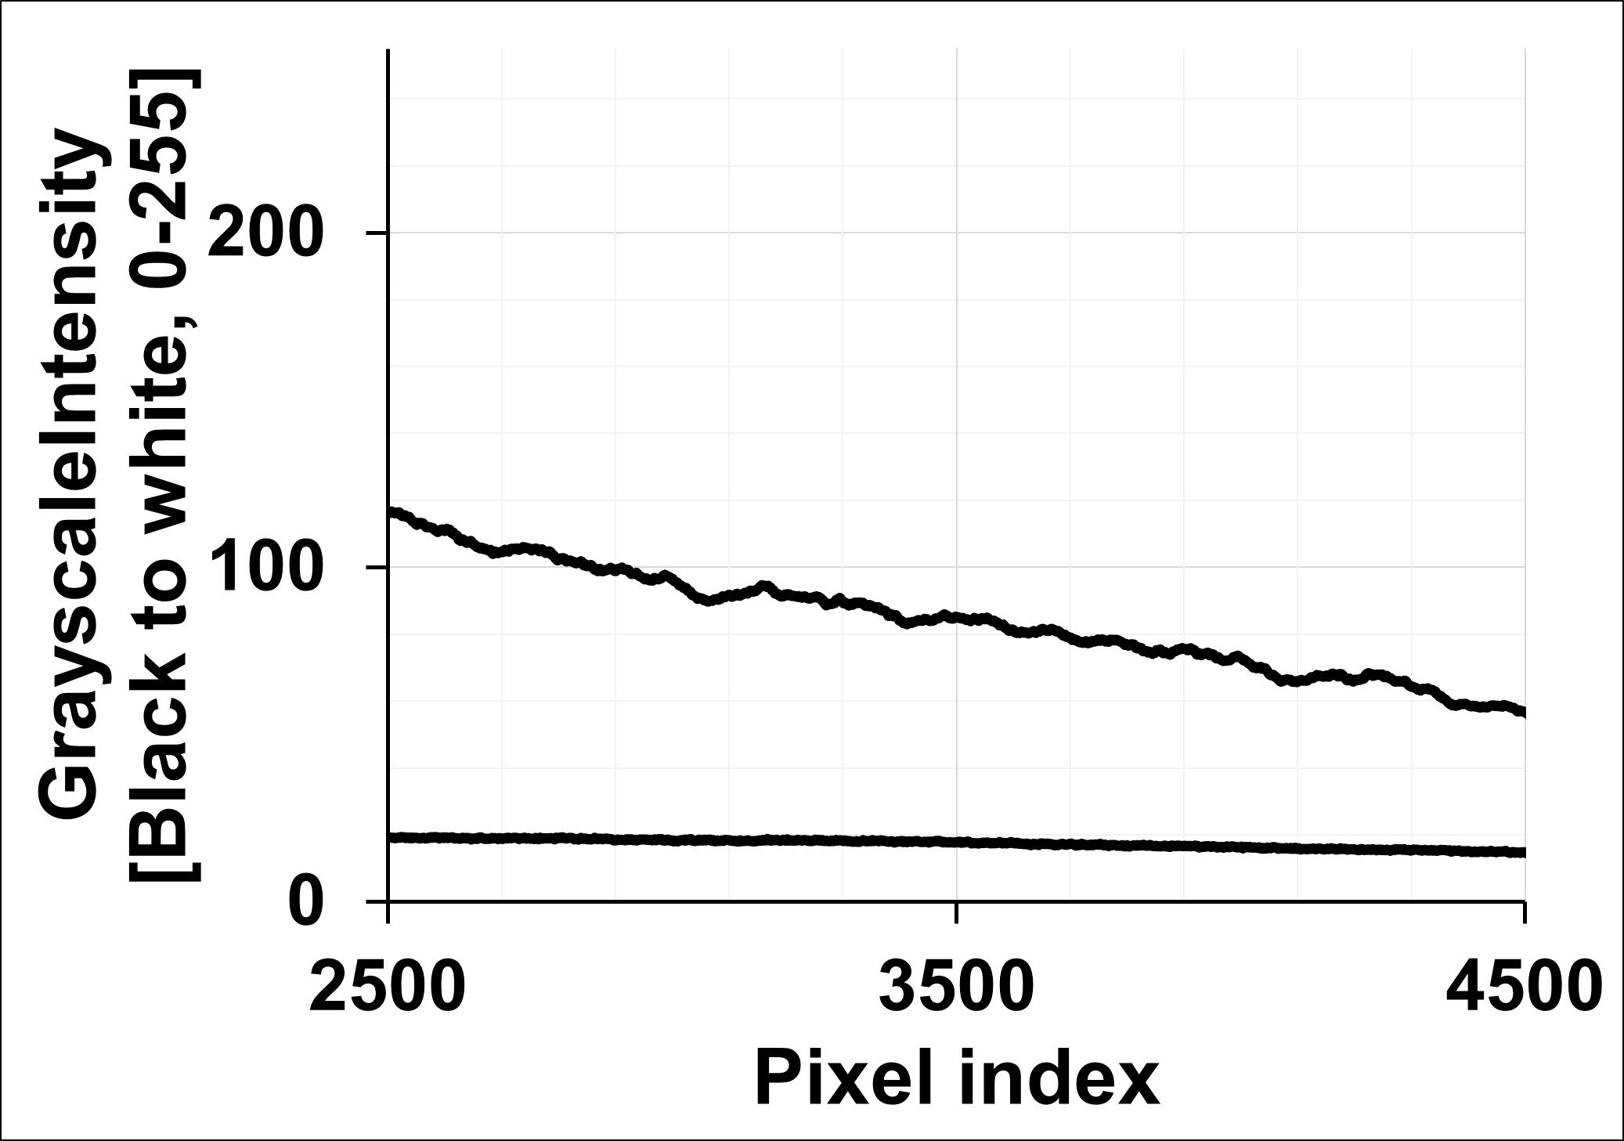
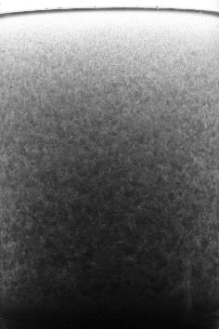
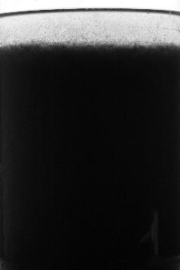
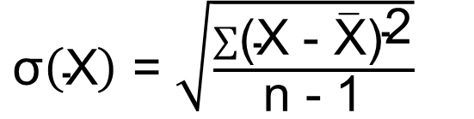
Approach
Standard deviation
Three methods to find significant change
Linear Fit
Slope and R²
Sigmoid Fit
B, C and Fit error
Noise Analysis
Mean std. deviation
$\text{σ}\left(\text{X}\right) \text{=}$ $\sqrt{\frac{\sum{{\text{(}\text{X} \text{−} \overline{\text{X}}\text{)}}^{\text{2}}}}{\text{n}\text{ − 1}}}$
Flocculent
Hindered

Slide 16
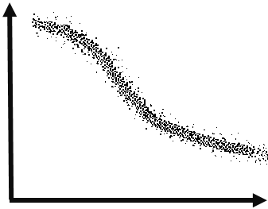
Approach
Standard deviation
Three methods to find significant change
Linear Fit
Slope and R²
Sigmoid Fit
B, C and Fit error
Noise Analysis
Mean std. deviation
$\text{σ}\left(\text{X}\right) \text{=}$ $\sqrt{\frac{\sum{{\text{(}\text{X} \text{−} \overline{\text{X}}\text{)}}^{\text{2}}}}{\text{n}\text{ − 1}}}$
n = 100
Y, Grayscale Intensity
n = 100
n = 100
…
X, Pixel index

Slide 17
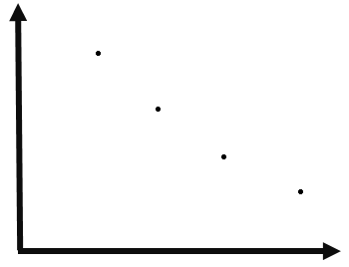
Approach
Standard deviation
Three methods to find significant change
Linear Fit
Slope and R²
Sigmoid Fit
B, C and Fit error
Noise Analysis
Mean std. deviation
$\text{σ}\left(\text{X}\right) \text{=}$ $\sqrt{\frac{\sum{{\text{(}\text{X} \text{−} \overline{\text{X}}\text{)}}^{\text{2}}}}{\text{n}\text{ − 1}}}$
Standard deviation
X, Pixel index/100

Slide 18
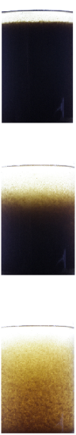
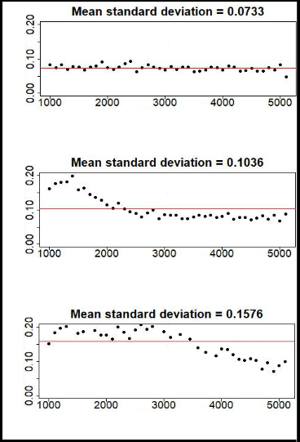
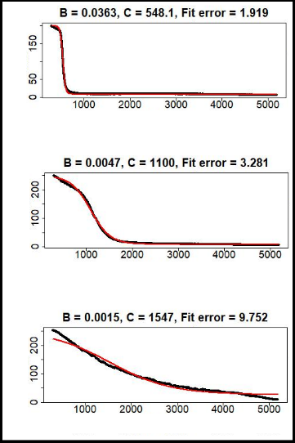
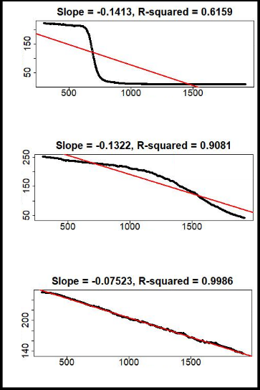
Noise Analysis
Sigmoid Fit
Linear Fit
Mean σ = 0.0733
B = 0.0363, C = 548.1, Fit error = 1.919
Slope = -0.1413, R² = 0.6159
Hindered
σ
Intensity
Intensity
Pixel index
Pixel index
Pixel index
Mean σ = 0.1036
B = 0.0047, C = 1100, Fit error = 3.281
Slope = -0.1322, R² = 0.9081
σ
Intensity
Intensity
Around LOSS
Pixel index
Pixel index
Pixel index
Mean σ = 0.1576
B = 0.0015, C = 1547, Fit error = 9.752
Slope = -0.0752, R² = 0.9986
σ
Flocculent
Intensity
Intensity
Pixel index
Pixel index
Pixel index
Mean σ
Fitted Sigmoid Curve
Regression Line

Slide 19
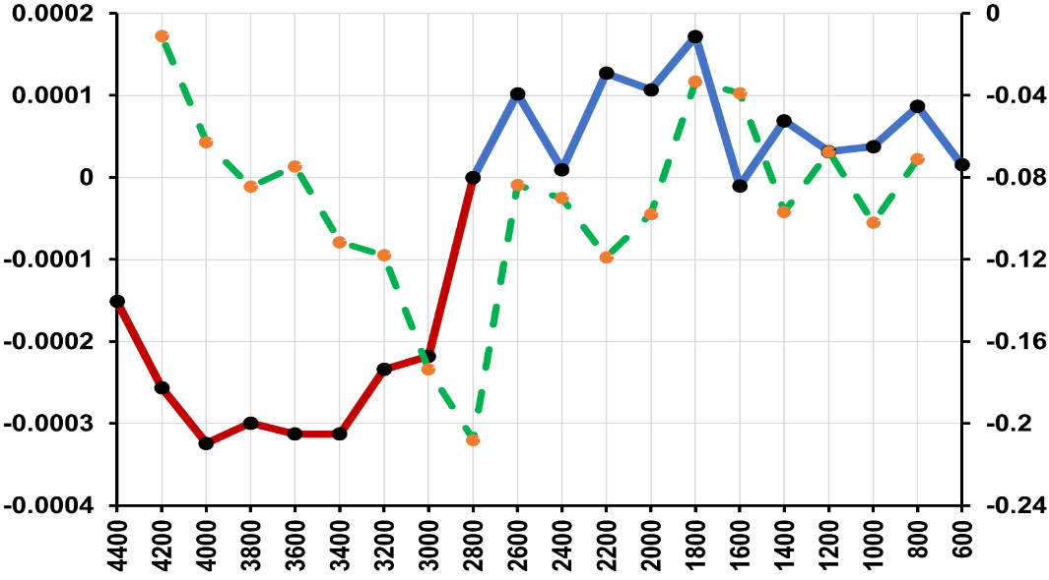
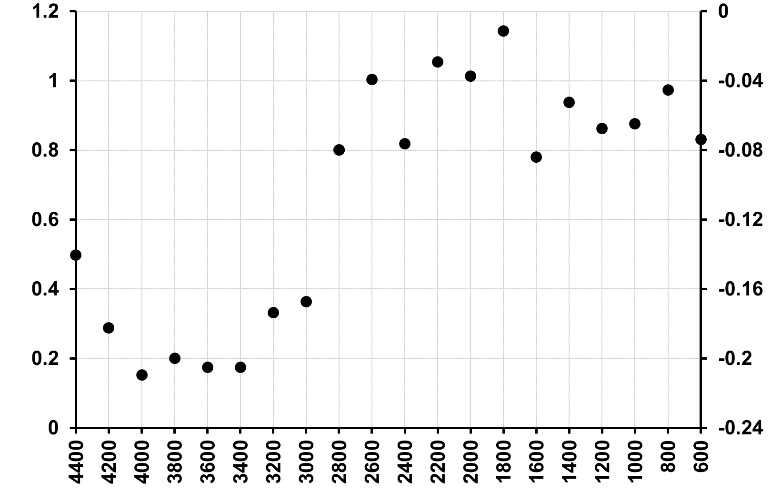
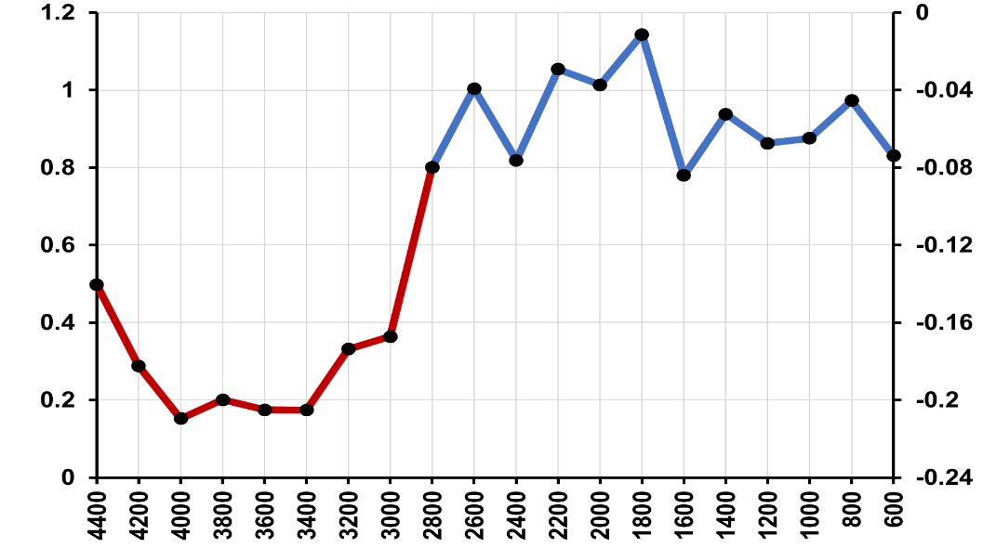
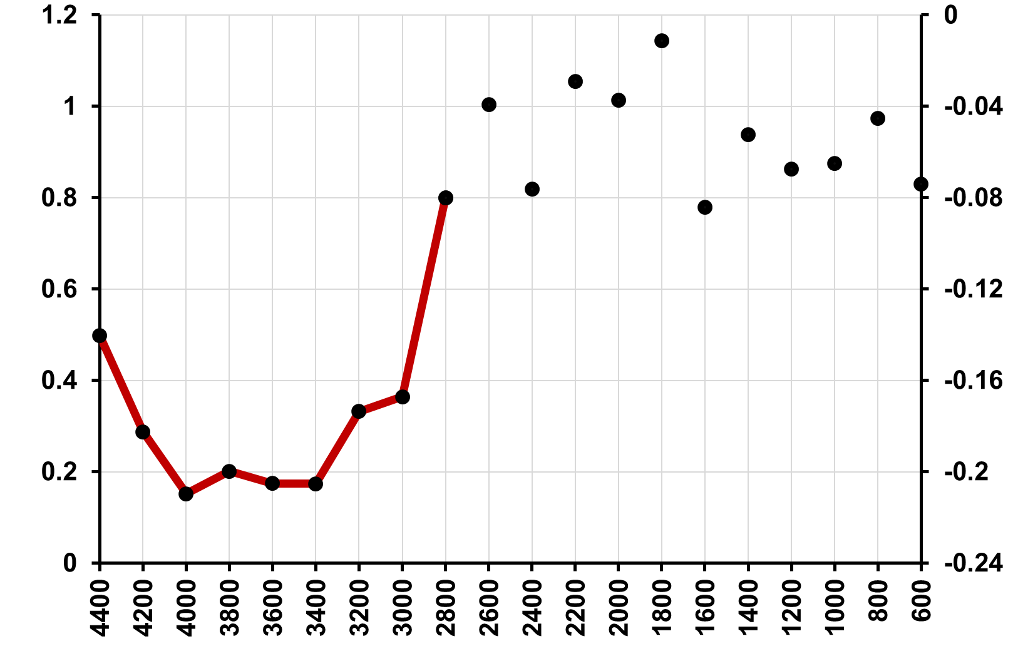
slope for every three points
Parameters e.g. Slope, R², B, C, Fit error, Mean σ, from each concentration
Slope of parameters
Percent change or Threshold > 50%
LOSS Concentration
MLSS concentration (mg/L)
Parameters (Hindered)
Parameters (Flocculent)
Slope of parameters

Slide 20

Findings
Compared three methods
Linear fit, Sigmoid fit, Noise Analysis
Compared six (6) light conditions
5, 10, 25, 50, 75, 200 intensities
Compared ten (10) settling times
0, 10, 20, 30, 40, 50, 60, 70, 80, 90 secs

Slide 21
Criteria for evaluation
1. Is a LOSS value consistently measurable?
For same method
For same light condition
For same settling time
2. Is the standard error between LOSS values less than ± 100 mgTSS/L?
For same method
Under practical light conditions and settling times that passed criteria 1

Slide 22
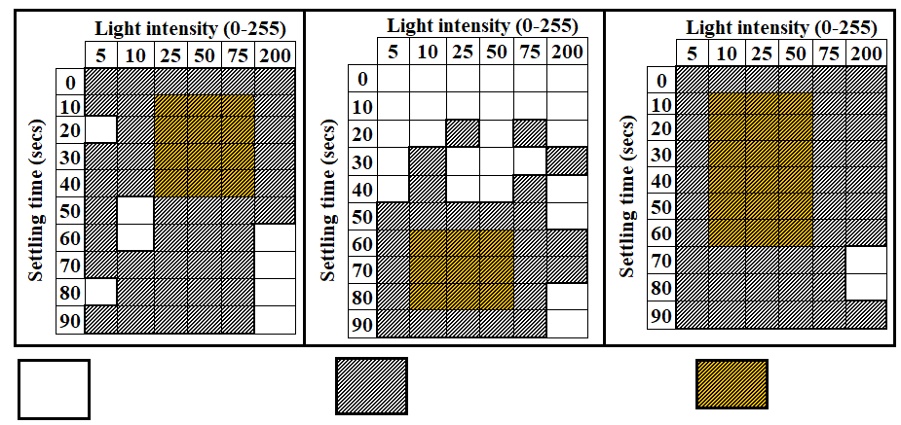
Consistency of determination
Linear Fit
Sigmoid Fit
Noise Analysis
Success rate across all samples
Linear – 87%
Sigmoid – 55%
Noise – 97%
Failed LOSS determination
Successful LOSS determination
Practical range for use

Slide 23
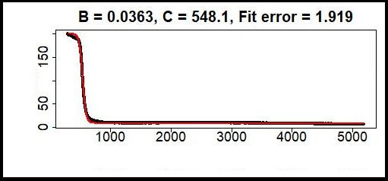
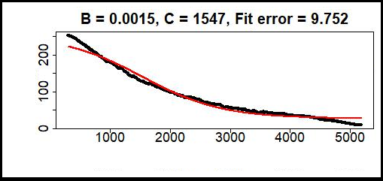
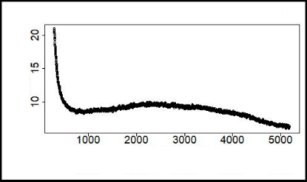
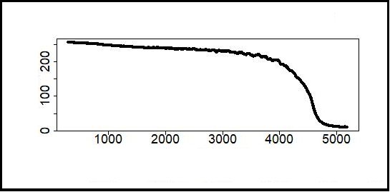
Sigmoid fitting was unworkable in some pictures due to their intensity profile
B = 0.0363, C = 548.1, Fit error = 1.919
B = 0.0015, C = 1547, Fit error = 9.752
Intensity
Intensity
Pixel index
Pixel index
Intensity
Intensity
Pixel index
Pixel index
Fitted Sigmoid Curve

Slide 24
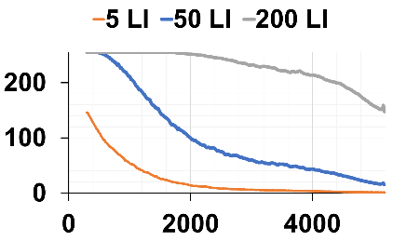



Consistency of determination
Too high/low brightness reduces information capacity
More apparent in flocculent profiles
Intensity
Pixel index
5 LI
50 LI
200 LI
Flocculent → 1000 MLSS, 30 secs of settling

Slide 25




Consistency of determination
Too high/low brightness reduces information capacity
More apparent in flocculent profiles
Intensity
Pixel index
5 LI
50 LI
200 LI
Hindered → 4000 MLSS, 30 secs of settling

Slide 26



Consistency of determination
Too high/low brightness reduces information capacity
More apparent in flocculent profiles
Intensity
Intensity
Intensity
Pixel index
Pixel index
Pixel index
200 LI, 30 secs settling
50 LI, 30 secs settling
5 LI, 30 secs settling

Slide 27



Consistency of determination
High settling time also reduces information capacity
More apparent at high light intensities
Flocculent profiles ‘look’ hindered or in compression
Intensity
Intensity
Intensity
Pixel index
Pixel index
Pixel index
200 LI, 80 secs settling
50 LI, 80 secs settling
5 LI, 80 secs settling

Slide 28



Intensity
Intensity
Intensity
Pixel index
Pixel index
Pixel index
200 LI, 80 secs settling
50 LI, 80 secs settling
5 LI, 80 secs settling
200 LI, 80 secs, 1000 MLSS
50 LI, 80 secs, 1000 MLSS
5 LI, 80 secs, 1000 MLSS

Slide 29
Precision of LOSS values
Linear Fit
Sigmoid Fit
Noise Analysis
Failed LOSS determination
Successful LOSS determination
Practical range for use

Slide 30



Precision of LOSS values
Linear Fit
Sigmoid Fit
Noise Analysis
Std. error (± mgTSS/L)
Std. error (± mgTSS/L)
Std. error (± mgTSS/L)
Sample
Sample
Secondary EAST
BNR
Secondary WEST
Criteria 2 ( < 100 mgTSS/L)

Slide 31



Noise Analysis
Sigmoid Fit
Linear Fit
Sample
Sample
Secondary EAST
Secondary WEST
BNR

Slide 32
Final Thoughts
Noise Analysis was the most reliable method for calculating the LOSS concentration
Suitable light conditions and settling times for LOSS experiments were determined
The Limit of Stokesian Settling (LOSS) could be used as a parameter for clarifier operation

Slide 33
References
Mancell-Egala, William ASK, David J. Kinnear, Kimberly L. Jones, Haydee De Clippeleir, Imre Takacs, and Sudhir N. Murthy. "Limit of stokesian settling concentration characterizes sludge settling velocity." Water research 90 (2016): 100-110.
Takács, Imre, Gilles G. Patry, and Daniel Nolasco. "A dynamic model of the clarification-thickening process." Water research 25, no. 10 (1991): 1263-1271.

Slide 34






Thanks for your attention!
Contact Information
Ola Olagunju
ola.olagunju@dcwater.com

Slide 35
Additional Slides

Slide 36
Limit of Stokesian Settling (LOSS)
Pros
Capture transition from flocculent to hindered
Provide maximum concentration to enter the clarifier feed well
Cons
NSS fraction

Slide 39


Slide 40


Slide 41


Slide 42




Slide 43


Slide 44


Slide 45


